Slide 1
Voice Driven
Password Lock
By: Onur Calisir and Steven Wang
Mechanical Engineering & Biochemistry

Slide 2
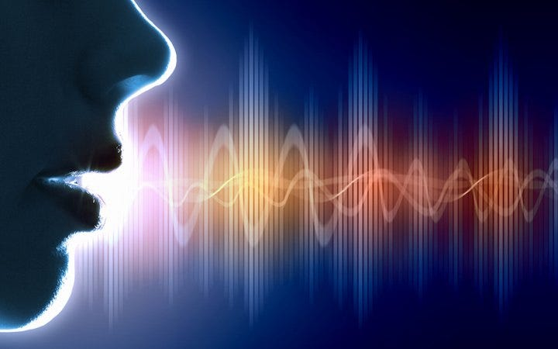
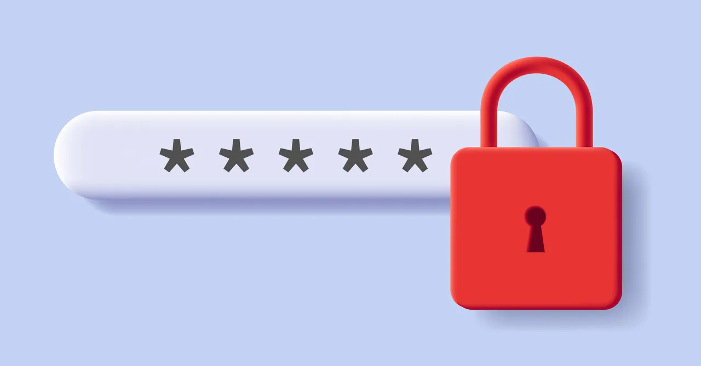
Introduction
The purpose of this experiment is to create a Voice Driven sound verification system using Fast Fourier Transform (FFT).
A sound wave will be recorded and the five most dominant FFT peaks will be stored as a password array. Once a password is set, an input sound wave can be recorded and compared to the password signal characteristic.
If the input sound wave’s FFT dominant frequencies match the password array’s stored FFT frequencies: this will be considered a successful attempt.
This experiment makes use of an Arduino Mega 2560 R3, a microphone module, 2 push-buttons, 2 LED’s and 2 pull-down resistors of 220 Ohms.
Notes:
A Sound wave is recorded and after the FFT analysis, the 5 most dominant peaks are stored into a password array. An input sound can then be played and compared to the stored password. If there is a match then the password will indicate a successful result; otherwise it will be a rejection result.

Slide 3
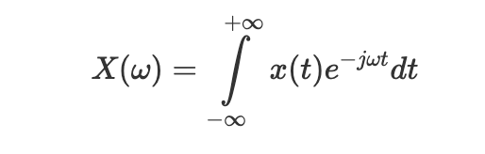
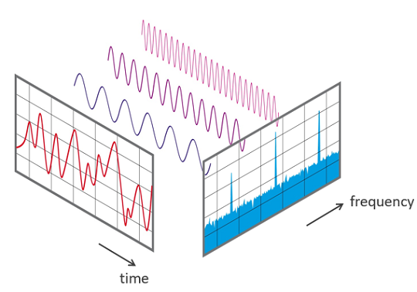
Theory - Fourier Transforms
FFT is a powerful tool that can be used to convert time-domain data into frequency-domain. An FFT allows for the decomposition of a sound wave into its constituent frequencies.
The Nyquist Theorem states that the sampling rate must be twice the highest frequency present to avoid any discrepancy. Adhering to this principle ensures that we capture enough data points from the analog signal to reconstruct it accurately without loss of fidelity in the digital domain.
If the sampling rate falls below the Nyquist rate: aliasing can occur where high-frequency components interfere with lower frequency readings, leading to distortion and misinterpretation of the signal.
To mitigate this, ensure that the sampling rate is sufficiently high enough. For data analysis, only consider frequency readings up to the Nyquist frequency which is defined as half the sampling frequency.

Slide 4
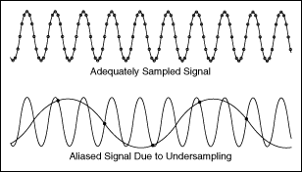
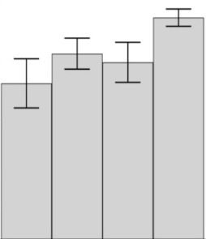
Tolerance Range
The Arduino’s FFT function cannot consistently produce the same values which is a consequence of background noise and undersampling.
A tolerance range was determined for precise and accurate password matching.
A 440 Hz square wave was used as a calibration signal, and it was observed that most dominant frequencies only differed about ±5 Hz from each other.
The Arduino code was adjusted to treat frequencies within the tolerance range as acceptable which led to decreased errors.
A tolerance of ±5 Hz was deemed to be very useful as our project managed to match password frequencies with input frequencies very successfully.
± 5
Notes:
Since the arduino’s FFT function cannot consistently produce the same values because of background noise and undersampling, a tolerance range was determined for more accurate password matching. A 440 Hz square wave was used for the calibration signal. It was discovered that the dominant frequencies only different around plus minus 5 hz. The arduino code took this tolerance range into consideration when matching password inputs which led to decreased errors.

Slide 5
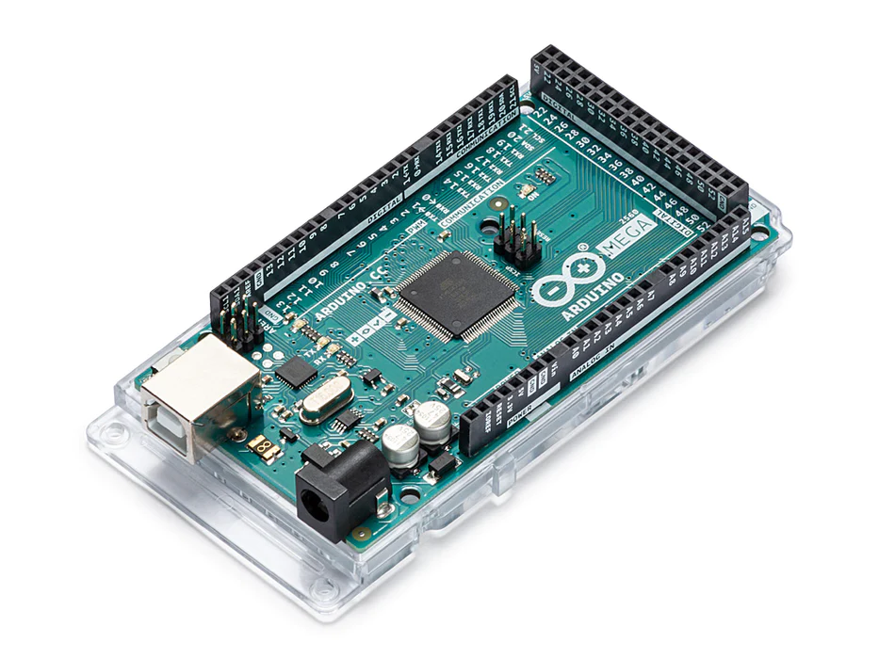



Microcontroller Selection
Due to memory limitations of the Arduino Uno board, we opted to use the Arduino Mega 2560 R3 board which has much higher processing memory. This allowed us to collect more samples (512 samples compared to 128 samples) of our voice recordings, leading to much more accurate frequency detections and password matching.
>>

Slide 6
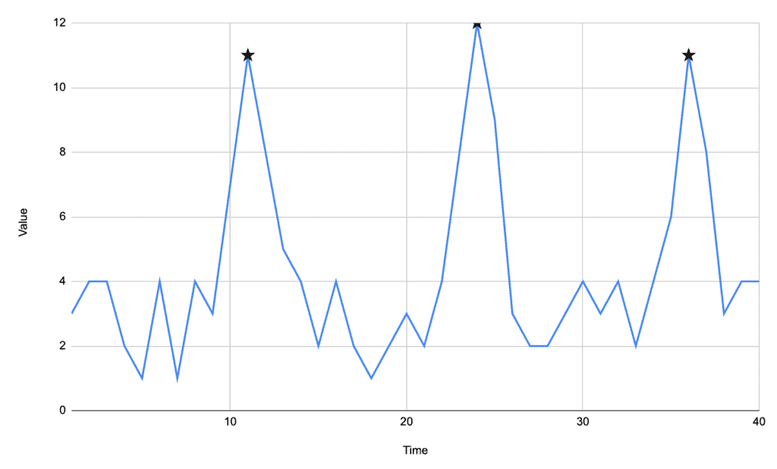

Result Prediction
Using a very low tolerance range, the system is made to be very robust and accurate.
The Arduino code is expected to provide the 5 most dominant frequencies for any given sound signal after the FFT program is used.
When setting a password, these 5 frequencies will be stored in an array and kept until a new password entry is recorded. Once an input signal has been been received, the Arduino will execute the same analysis and compare the frequencies found for the input with the password frequency array.
If ⅗ of the input frequencies are found to be within the tolerance range of the password frequencies then it will be successful.
If this constraint is not met, the system is anticipated to realize the signals are not the same resulting in an unsuccessful attempt.
Notes:
The tolerance range allows for a more robust and accurate system. The arduino code provides the 5 most dominant frequencies for a given sound signal. When setting the password, the 5 frequencies will be stored in an array. An input signal will be received and perform the same FFT analysis and compare the input to the stored password array. If ⅗ of the input frequencies are within the tolerance range it will be considered a success. If not, the system will realize the sounds are not the same resulting in an unsuccessful attempt.

Slide 7
Determining the Sampling Frequency
Previously mentioned, the sampling frequency plays a crucial role in the FFT analysis. The sampling frequency provides insight on how many data points can be collected for data analysis. This provided a large set-back for the project since the sampling rate is hugely impacted by the FFT analysis, slowing the data collection significantly. Thus, 2 different sampling frequencies were used:
The true sampling frequency of the microphone module: this was determined by the analog output collection done by a simpler Arduino code. For Python analysis, the true sampling rate of the microphone can be calculated by dividing the number of samples by the sampling duration (seconds), which had an average value of 2595 Hz.
The sampling frequency for the Arduino FFT analysis: this proved to be the main issue as the FFT analysis slowed down the data acquisition. This meant that less samples could be collected. By trial and error, this sampling frequency was found to be around 950 Hz.

Slide 8
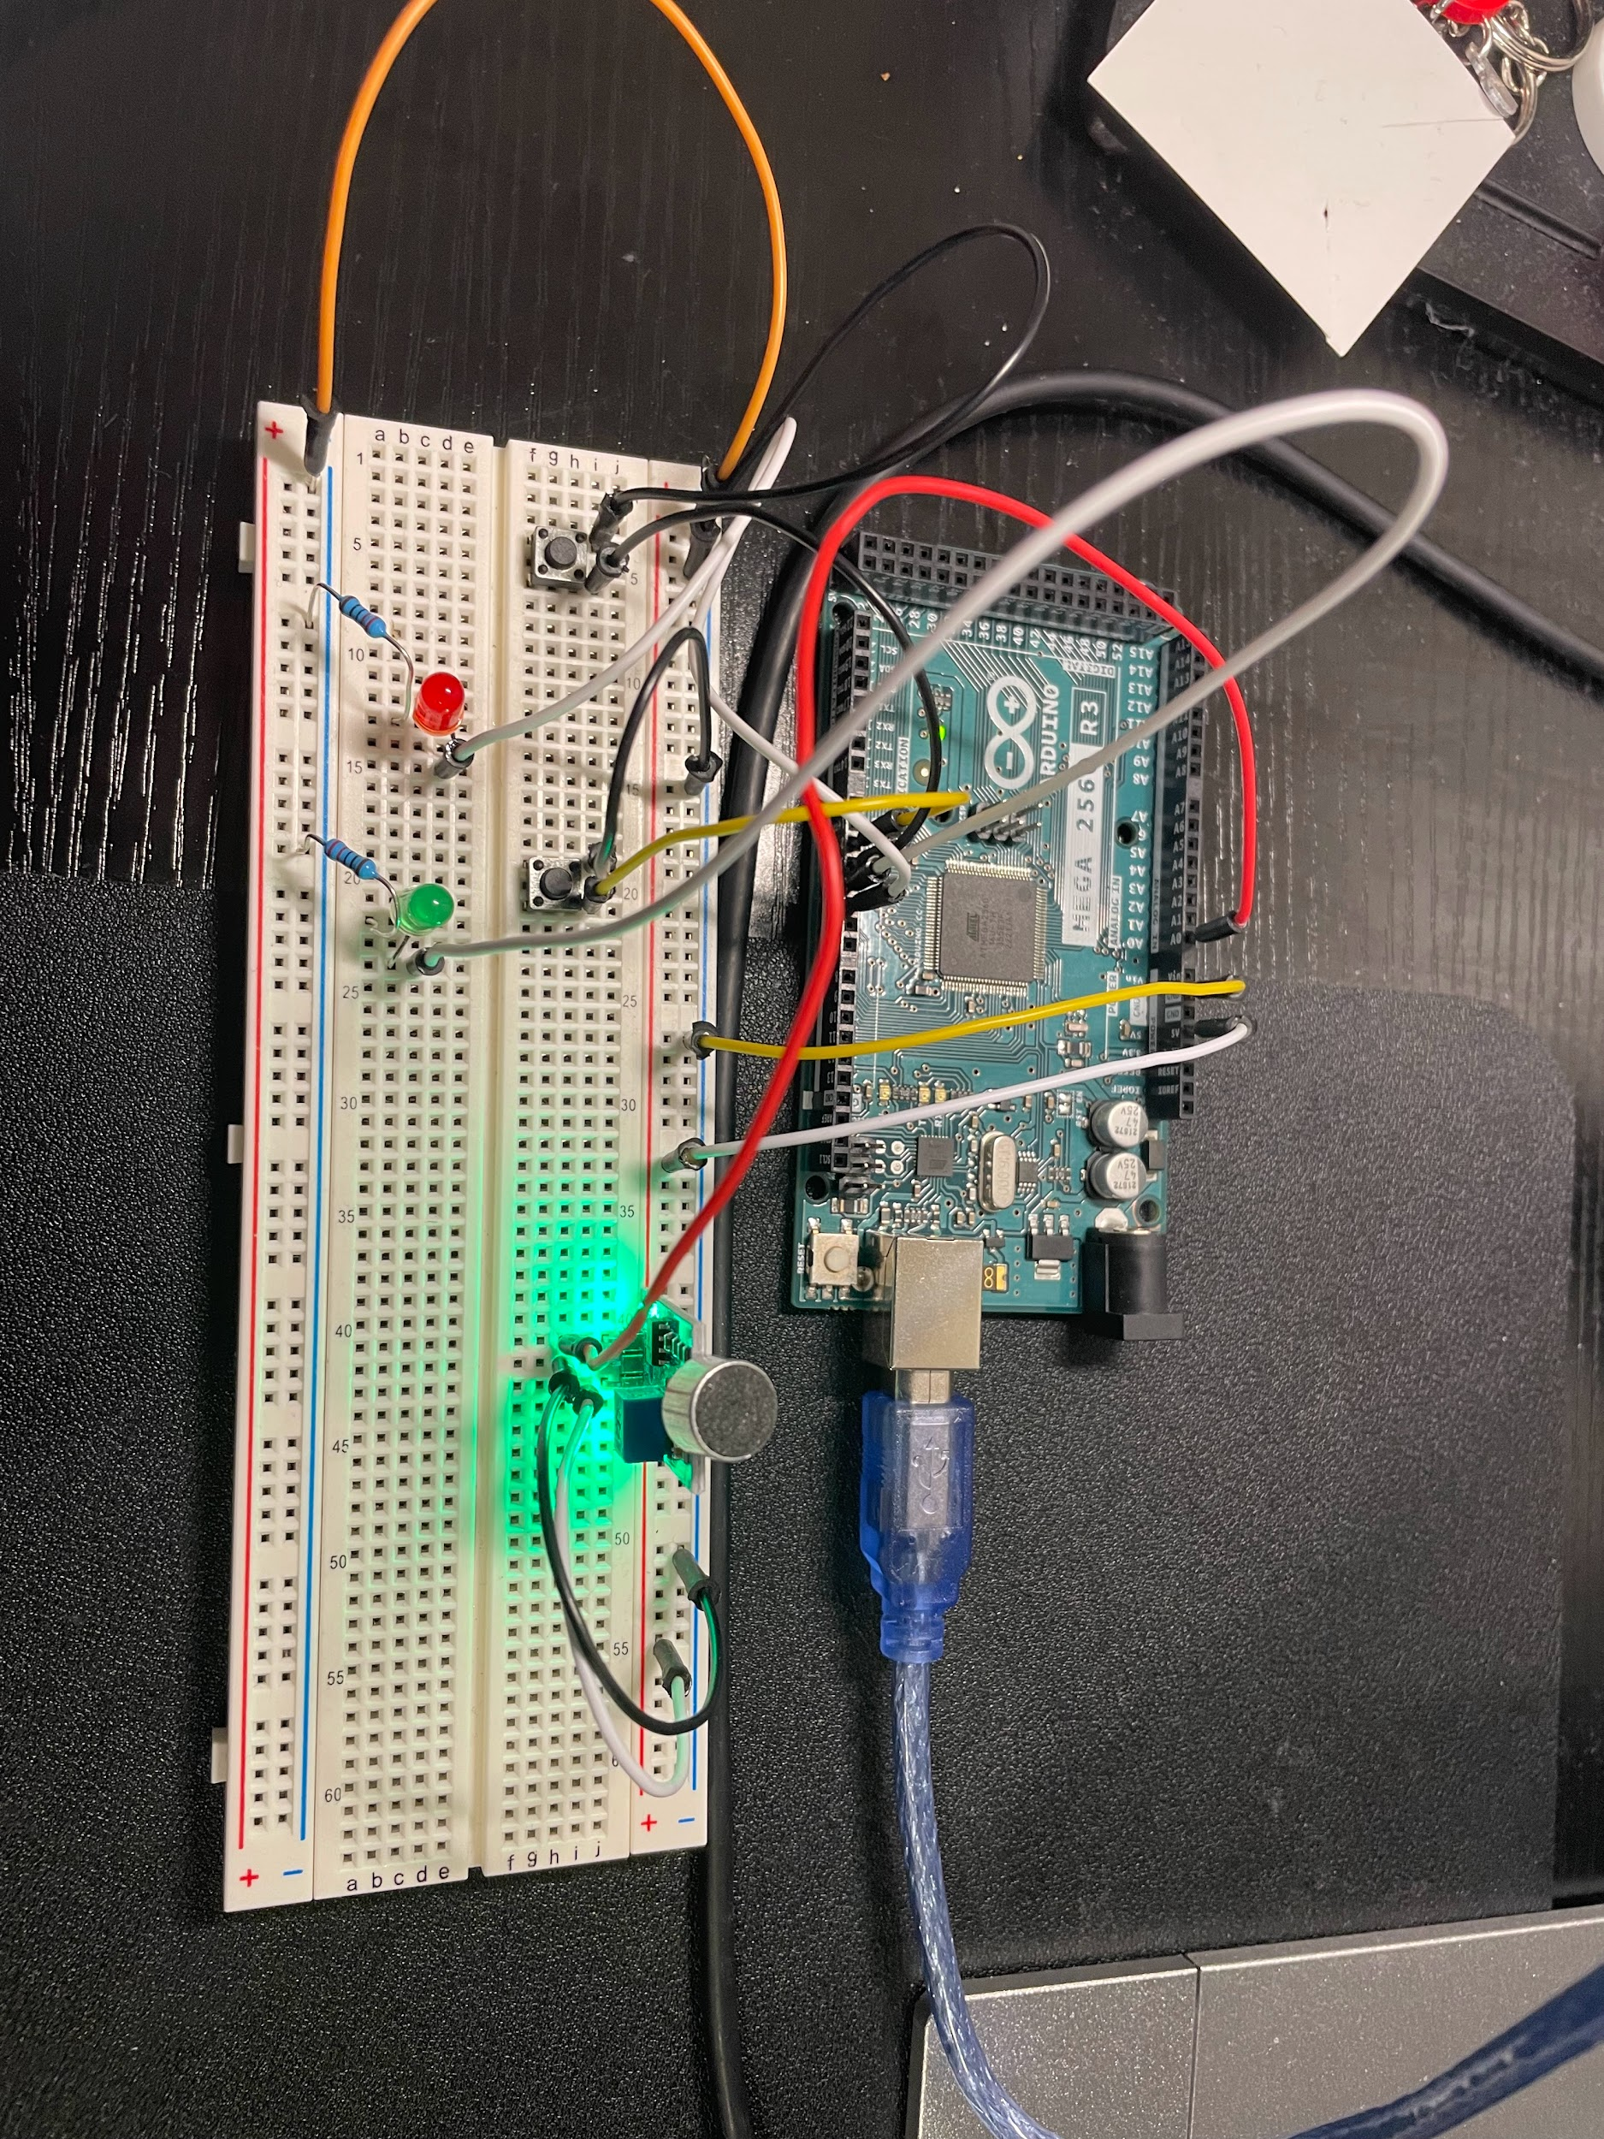
Our Experimental Setup
Arduino Mega 2560 R3
Arduino as the microcontroller
Microphone to collect sound input for password matching or setting
Two pushbuttons, leftmost is used for recording sound inputs and the right one matches the sound input with the password array of pre-recorded sample.
Two 220Ω resistors used as pull down resistors to control voltage through the LED lights.
LED Lights: Red will indicate unsuccessful match and Green indicates successful match
Microphone Module
Password
Setting button
input sound
record password
Input Button
microphone
220Ω resistor
LED lights
LED’s
220 Ω Pull down resistors

Slide 9


Data Taking and Analysis
Using the experimental setup, the tolerance range was obtained using various sound waves taken five separate times
The standard deviation of a 440 Hz square wave was found between the 5 most dominant FFT peaks and a tolerance of ±5 Hz was determined.
Different input sounds were each tested 20 times.10 were of the same sound and 10 of a different sound.
If the input sound’s 5 most dominant peaks were each within ±5 Hz of ⅗ the password array’s stored peaks it was considered a success. A negative test was also performed where a different sound was played and matched with the password array, the expected result was a rejection.
Notes:
So after finding the tolerance range, the input sounds were tested 20 times. 10 for the same sound and 10 for a different sound. If the input sound’s 5 most dominant peaks were each within plus minus 5 hz of the password array it was considered a success. A negative test was also performed to see if a different sound was played it would result in a rejection.

Slide 10
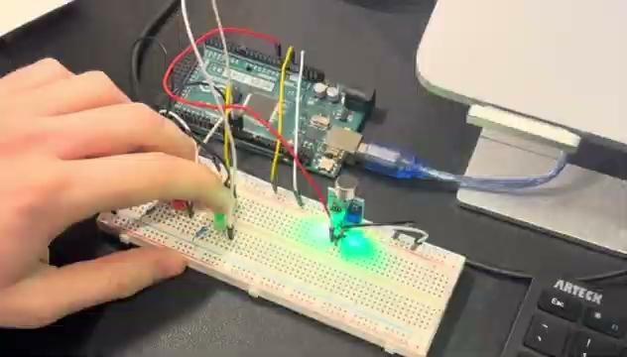
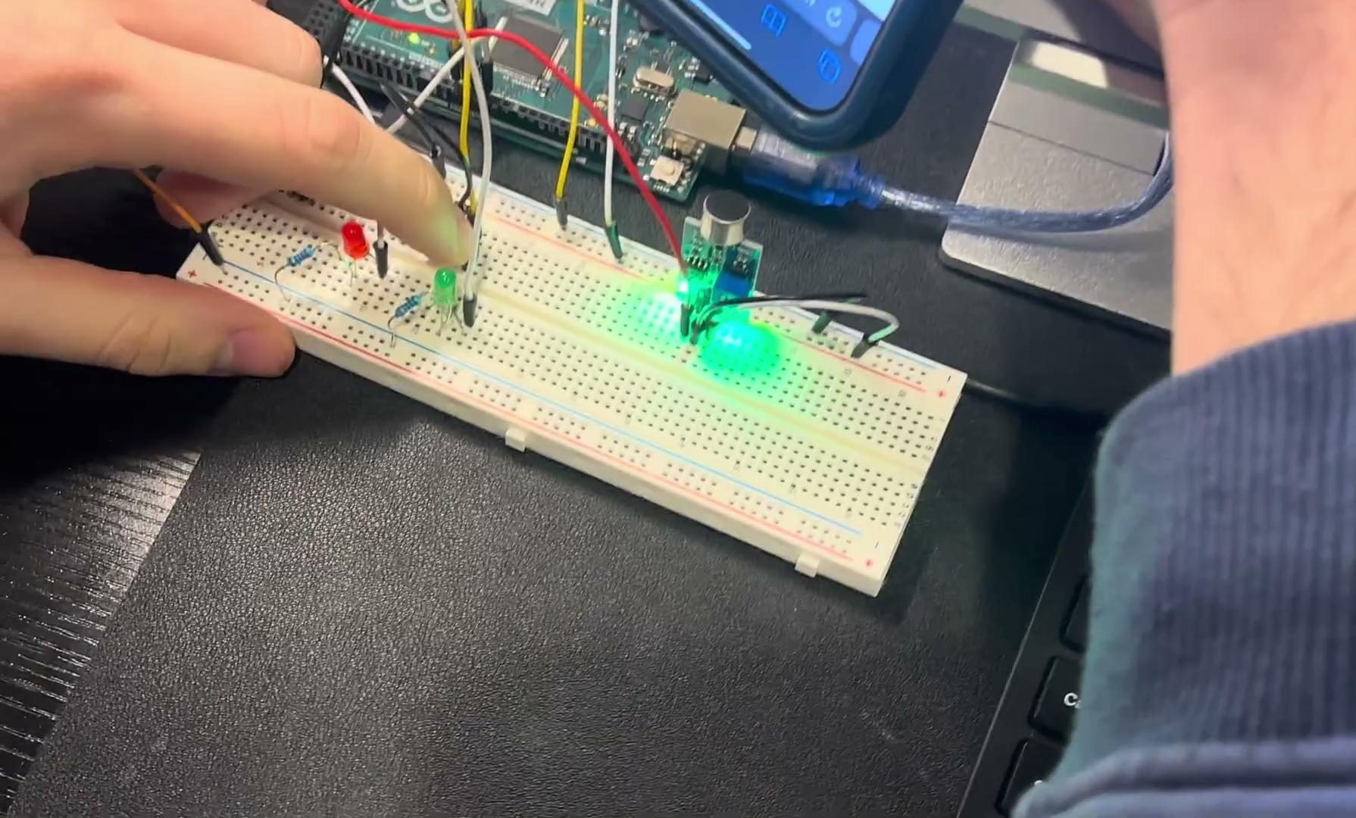
Videos
200 Hz Chirp Signal Test
400 Hz Square Wave Signal Test

Slide 11
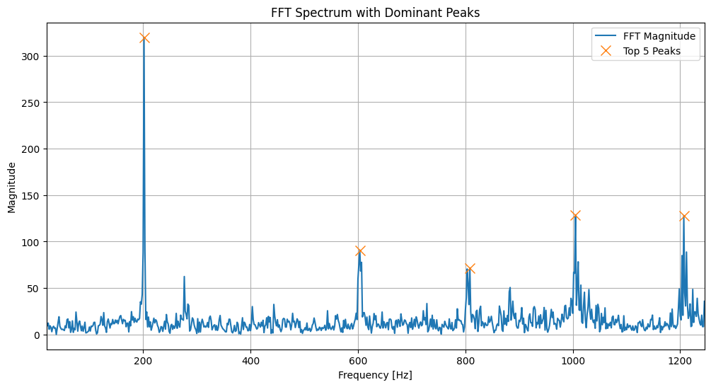
Results - 200 Hz Chirp
Password Array = [ 221.60, 223.42, 181.64, 179.82, 303.34 ] Hz
Input Array1 = [ 221.60, 181.64, 223.42, 263.68, 393.34] Hz
⅗ match: Verification Successful
Input Array2 = [ 181.64, 221.60, 223.42, 263.38, 303.34 ] Hz
⅘ match: Verification Successful
Input Array3 = [ 221.60, 223.42, 181.64, 303.34, 263.38 ]Hz
⅘ match: Verification Successful
Input Array4 = [221.60, 181.64, 223.42, 263.38, 179.82 Hz ] Hz
⅘ match: Verification Successful
The 5 most dominant frequencies found by Python:
[ 201.67, 1005.00, 1206.67, 603.33, 808.33] Hz
± 5 Hz Tolerance is Acceptable
Signal | Accurate Acceptance | Accurate Rejection
200 Hz Chirp | 10/10 | 10/10

Slide 12
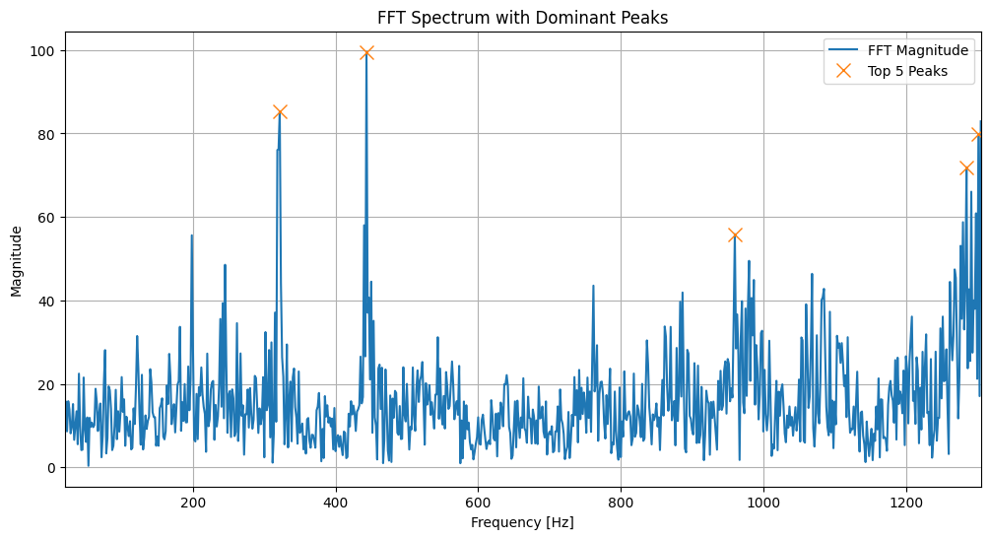
Results - 440 Hz Square Wave
Password Array = [394.16, 346.93, 94.45,441.39, 392.34 ] Hz
Input Array1 = [ 394.16, 346.93, 94.45, 392.34, 345.12 ] Hz
⅗ match: verification successful
Input Array2 = [394.16, 346.93, 94.45, 392.34, 345.12 ] Hz
⅘ match: verification successful
Input Array3 = [394.16, 346.93, 94.45, 345.12, 441.39 ] Hz
⅘ match: verification successful
Input Array4 = [346.93, 394.16, 94.45, 188.91, 441.39 ] Hz
⅘ match: verification successful
The 5 most dominant frequencies found by Python: [ 443.33 , 321.67, 1301.67, 1285, 960 ] Hz
± 5 Hz Tolerance is Acceptable
Signal | Acceptance | Rejection
440 Hz Square Wave | 10/10 | 10/10

Slide 13
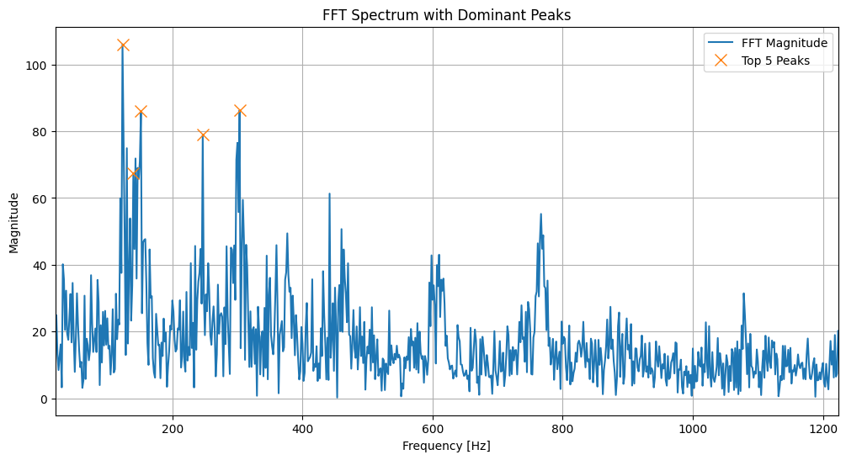
Result - “1 2 3” Onur
Password Array = [132.60, 261.56, 254.30, 268.83, 245.21]Hz
± 5 Hz Tolerance
Input Array1 = [ 245.21, 239.77, 121.70, 237.95, 243.40 ] Hz
⅕ match: verification unsuccessful
Input Array2 = [ 245.21, 239.77, 121.70, 237.95, 243.40 ] Hz
⅕ match: verification unsuccessful
± 20 Hz Tolerance
Input Array3 = [ 245.21, 252.48, 121.70, 119.88, 243.40 ] Hz
4/5 match: verification successful
Input Array4 = [ 256.11, 130.78 , 257.93, 245.21, 250.66 ] Hz
5/5 match: verification successful
Signal | Acceptance | Rejection
“1 2 3” Onur [±5 tolerance] | 3/10 | 10/10
“1 2 3” Onur [±15 tolerance] | 10/10 | 10/10
The 5 most dominant frequencies found by Python: [ 123.34, 303.33, 151.67, 246.67, 140.00 ] Hz
± 5 Hz Tolerance is NOT Acceptable
± 15Hz Tolerance is Acceptable
Notes:
Figures from Python were included that depicted the results. There should be a clear indication of the theory within the results or a discussion as to why there is not. (10 points)

Slide 14
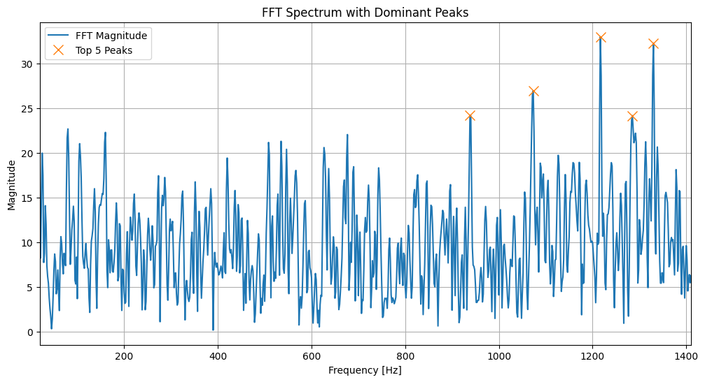
Results - C-Major Piano Chord
Password Array = [ 365.10, 435.94, 434.12, 197.99, 203.44 ] Hz
± 15 Hz Tolerance
Input Array1 = [365.10, 363.28, 366.91, 435.94, 376.00 ] Hz
2 /5 match: verification rejected
Input Array2 = [434.12, 435.94, 197.99, 196.17, 365.10] Hz
⅘ match: verification successful
Input Array3 = [ 435.94, 365.10, 366.91,183.46, 437.75 ] Hz
⅘ match: verification successful
Input Array4 = [ 435.94, 434.12, 197.99, 199.80, 432.30 ] Hz
⅘ match: verification successful
The 5 most dominant frequencies found by Python:
[ 1216.67 1330.00 1073.33 938.33 1285.00 ] Hz
± 5 Hz Tolerance is NOT Acceptable
± 15 Hz Tolerance is the most Acceptable
Signal | Acceptance | Rejection
C-Major [ ± 5 tolerance ] | 2/10 | 10/10
C-Major[ ± 15 tolerance ] | 8/10 | 9/10

Slide 15
Discussion
Limitations: The greatest limitation of our project was the low processing memory of the Arduino boards, even with the more powerful Arduino Mega, we were only able to collect 512 samples per recording for FFT analysis, compared with ~1500 samples taken without the FFT analysis.
The Nyquist theorem was observed experimentally. The Arduino board could only manage a sampling frequency of 950 Hz, which meant that the highest frequency signal that could be tested was 950/2 = 475 Hz. Signals with frequencies higher than 475 Hz saw drastic changes in their calculated frequency peaks, as aliasing effects pushed higher frequency components to interfere with the lower frequencies and yielded inaccurate results.
The effects of higher harmonic frequencies were observed for the C major chord test signal. Even though the Arduino collected the first harmonic frequencies, the Python analysis was only able to find the higher frequency harmonics which increased the error in the analysis.
Errors:
Most errors arises when a non uniform test signal was used, such as “word” triggers.
The system is more accurate with continuous signals such as sound waves. Non-uniform sound waves provide more variations in data that cannot be matched within a 5 Hz tolerance range. So for these types of signals, a more accommodating tolerance range of 15 Hz was used.
The frequencies found by the Arduino largely differed from the frequencies found by the Python analysis. This is due to the differences in the FFT software used by these programs, and the amount of samples used for each analysis.
For the C major tests, the Python software was only able to detect the higher harmonic frequencies of the signal, which did not agree with the Arduino’s findings.
Notes:
Discussion provided about how the results related back to the theory. (10 points)

Slide 16
Conclusion and Future Extensions
The system performed exceptionally well with continuous uniform signals and were the most optimal.
A difficulty of this experiment was the word and harmonic frequencies which need a much higher tolerance range. The tolerance range was increased from 5 to 15 Hz.
Arduino FFT peaks differ largely compared to the python FFT peaks. This highlights the limitations and capacity of relying on Arduino. A better system can be utilized to create more meaningful results.
Future extensions of the work can be to include an actual mechanic lock. This can then be utilized to create a sound based verification system that can be implemented for doors and safes.
An improvement to this system can be to increase the sampling rate so that higher frequency sounds can be stored in the password array.
This system can further be improved upon by adding a better microcontroller. This will allow for more memory that can permit more storage of different passwords and more accurate password matching

